Slide 1

Comparison Analysis of OTT Platforms
Presented By Bader Nader

Slide 2
CONTENTS
Problem Statement
Objectives
Data Overview
Dashboard Preview
Insights
Summary

Slide 3
PROBLEM STATEMENT
Lio, a major telecom provider, is planning a strategic merger with Jotstar, a leading OTT platform. The goal is to combine LioCinema’s extensive subscriber base with Jotstar’s diverse content library to establish a dominant streaming service in India.
To ensure a successful merger, the management requires a detailed comparison of both platforms, analyzing user engagement, content consumption, subscription trends, and overall platform performance.
This study will provide insights to optimize content strategy, improve user retention, and enhance the profitability of the newly merged entity.

Slide 4
OBJECTIVES
Analyze Platform Performance: Compare user engagement, subscription trends, and financial performance between LioCinema and Jotstar.
Understand User Behavior: Identify patterns in content consumption, upgrade/downgrade trends, and inactivity rates.
Optimize Content Strategy: Evaluate content preferences by genre, language, and format to enhance platform appeal.
Improve Monetization: Assess paid vs. free user distribution and recommend strategies to maximize revenue and conversion rates.
Support Merger Decisions: Provide data-driven insights to help management create a competitive, unified OTT platform.

Slide 5
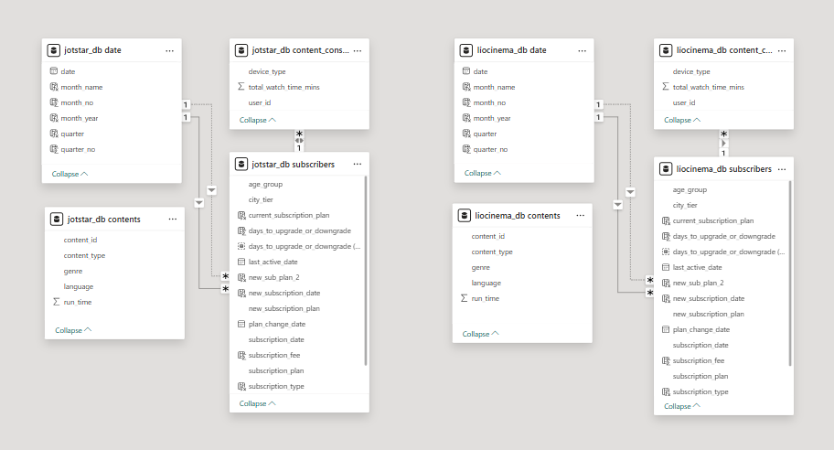
DATA OVERVIEW

Slide 6
Dashboard Overview

Slide 7


Slide 8
Insights

Slide 9
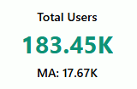
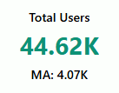
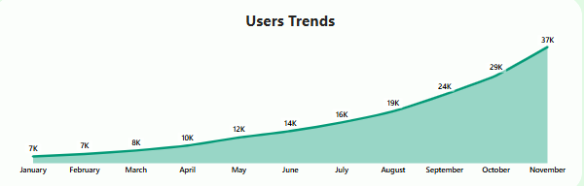
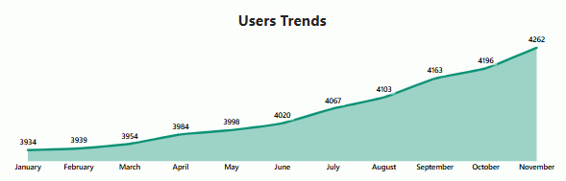
Q1. What is the total number of users for LioCinema and Jotstar, and how do they compare in terms of growth trends (January–November 2024)?
LIOCINEMA
JOTSTAR

Slide 10
Insights & Recommendations
Insights:
Liocinema has over four times the users of Jotstar, indicating a more established market presence.
Both platforms are experiencing steady user growth, showing increasing engagement.
Jotstar, though smaller, has a strong upward trend, making it a potential high-growth platform.
Liocinema’s growth is slowing, possibly due to market saturation.
Jotstar’s growth is more organic, while Liocinema may need aggressive strategies to sustain its lead.
Recommendations:
Jotstar:
Increase marketing efforts to accelerate user acquisition.
Expand partnerships to drive more engagement.
Focus on user retention strategies to sustain long-term growth.
Liocinema:
Improve engagement strategies to retain existing users.
Offer exclusive content to differentiate from competitors.
Strengthen marketing in underperforming segments.

Slide 11


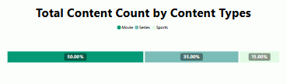
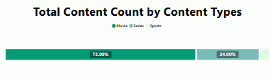
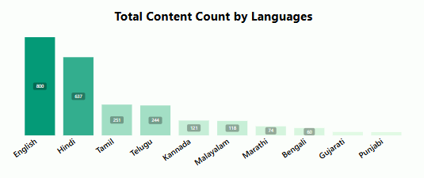
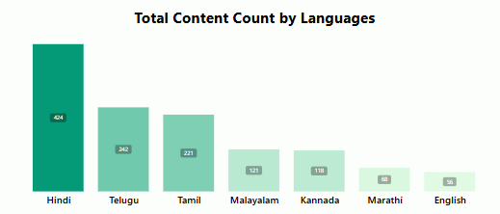
Q2. What is the total number of contents available on LioCinema vs. Jotstar? How do they differ in terms of language and content type?
JOTSTAR
LIOCINEMA

Slide 12
Insights & Recommendations
Insights:
Liocinema offers nearly twice as much content as Jotstar, positioning itself as a more comprehensive platform.
Jotstar’s content distribution is more balanced across movies, series, and sports, offering variety.
Liocinema is heavily focused on movies, with limited sports and series content.
Jotstar caters more to English and Hindi-speaking audiences, while Liocinema has a stronger regional language presence.
Liocinema’s limited diversity in content types could impact engagement over time.
Recommendations:
Jotstar:
Expand regional language content.
Increase investment in exclusive content.
Enhance sports and series offerings.
Liocinema:
Diversify content to include more series and sports.
Improve language-based personalization.
Strengthen partnerships with regional content creators.

Slide 13
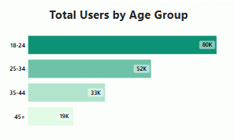
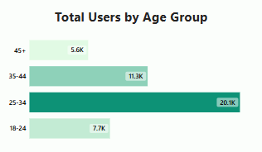
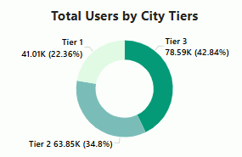
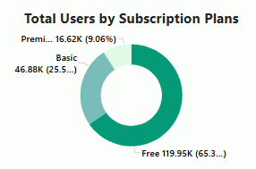
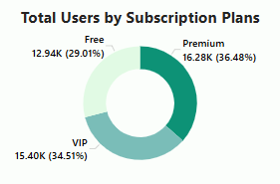
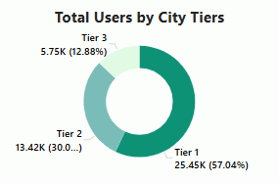
Q3. What is the distribution of users by age group, city tier, and subscription plan for each platform?
LIOCINEMA
JOTSTAR

Slide 14
Insights & Recommendations
Insights:
Jotstar has an older audience (25-34), while Liocinema is more popular among younger users (18-24).
Jotstar has a higher percentage of premium users, indicating stronger monetization.
Liocinema has a large free user base, suggesting a potential for monetization but lower conversion rates.
Jotstar performs well in Tier 1 cities, while Liocinema has more traction in Tier 3 cities.
The difference in audience demographics requires different engagement strategies.
Recommendations:
Jotstar:
Introduce pricing models tailored to younger audiences.
Expand outreach to Tier 3 cities.
Improve engagement for free users to increase conversions.
Liocinema:
Strengthen premium-tier benefits to drive conversions.
Personalize offers for younger users.
Enhance content targeting for different city tiers.

Slide 15
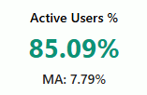
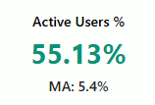
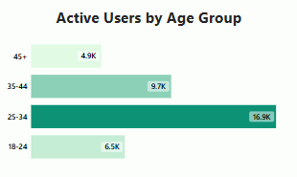
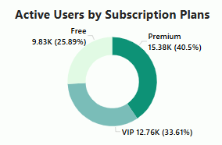
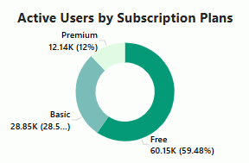
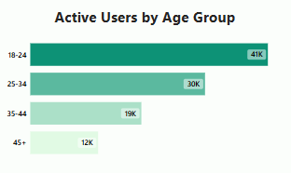
Q4. What percentage of LioCinema and Jotstar users are active vs. inactive? How do these rates vary by age group and subscription plan?
Active Users %
JOTSTAR
LIOCINEMA

Slide 16
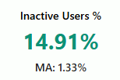
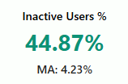
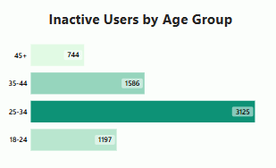
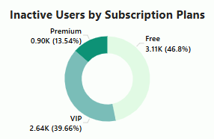
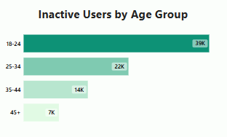
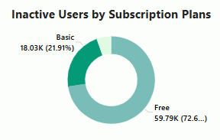
Inactive Users %
JOTSTAR
LIOCINEMA

Slide 17
Insights & Recommendations
Insights:
Jotstar has a significantly higher percentage of active users (85%) compared to Liocinema (55%).
Liocinema’s large inactive user base signals engagement challenges.
Free users are the most inactive on both platforms, reducing monetization potential.
Jotstar’s premium users are more engaged than Liocinema’s premium users.
Re-engagement strategies could improve retention on both platforms.
Recommendations:
Jotstar:
Maintain engagement through personalized content.
Strengthen loyalty programs for active users.
Introduce gamification to boost retention.
Liocinema:
Implement targeted re-engagement campaigns.
Offer exclusive perks to retain users.
Improve onboarding experiences for new users.

Slide 18
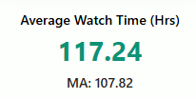
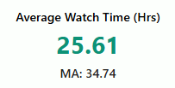
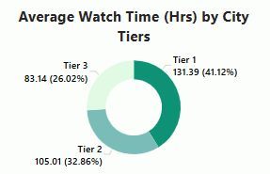
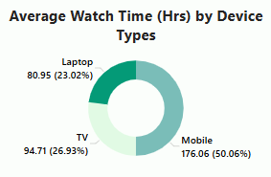
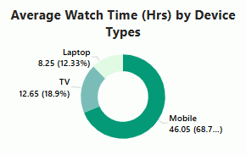
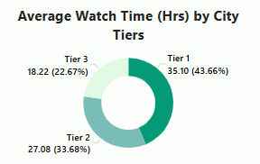
Q5. What is the average watch time for LioCinema vs. Jotstar during the analysis period? How do these compare by city tier and device type?
JOTSTAR
LIOCINEMA

Slide 19
Insights & Recommendations
Insights:
Jotstar users watch nearly 5x more content than Liocinema users.
Mobile is the dominant viewing device, but Jotstar has higher engagement on TV and laptops.
Tier 1 cities have the highest watch time on both platforms.
Liocinema’s lower watch time suggests content stickiness issues.
Strengthening content quality and user experience could improve engagement.
Recommendations:
Jotstar:
Optimize mobile experience for longer sessions.
Enhance content discoverability.
Invest in interactive features to boost engagement.
Liocinema:
Improve mobile-friendly content delivery.
Offer binge-worthy content for extended sessions.
Optimize recommendations to increase watch time.

Slide 20
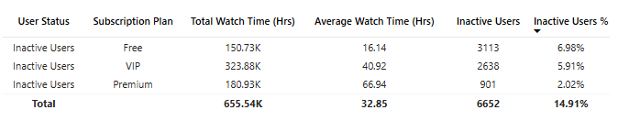
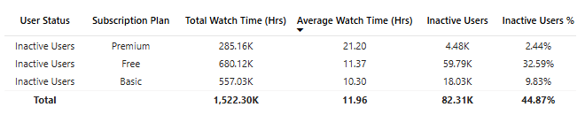
Q6. How do inactivity patterns correlate with total watch time or average watch time? Are less engaged users more likely to become inactive?
JOTSTAR
LIOCINEMA

Slide 21
Jotstar
Insights:
Users with lower average watch time (Free plan) have the highest inactivity rate, confirming that less engaged users are more likely to become inactive.
VIP users, who watch more hours on average, have a lower inactivity rate than Free users but still higher than Premium users.
Premium users have the highest average watch time per user and the lowest inactivity rate, showing that higher engagement correlates with lower inactivity.
Recommendations:
Increase Engagement for Free Users: Implement personalized content recommendations and limited-time exclusive access to premium content to encourage longer watch times and reduce inactivity.
Retain VIP Users: Offer loyalty rewards or exclusive in-app experiences to VIP users who show high watch time but still risk becoming inactive, ensuring they stay engaged and feel valued.
Enhance Premium Plan Stickiness: Introduce long-term subscription discounts or bonus perks for Premium users to maintain their high engagement levels and prevent potential drop-offs.

Slide 22
Liocinema
Insights:
Higher inactivity is associated with lower engagement (Free Plan users have both the highest inactivity rate and the lowest average watch time).
Premium users have the lowest inactivity rate but the highest average watch time, confirming that users who spend more time watching content are less likely to become inactive.
Basic users fall in between—lower engagement than Premium but better than Free, leading to a moderate inactivity rate.
Recommendations:
Improve Free Plan Engagement: Offer personalized content recommendations or limited-time premium content trials to encourage Free users to watch more and stay engaged.
Enhance Retention Strategies for Basic Users: Introduce loyalty-based incentives like exclusive content, discounts on upgrades, or interactive features to increase their watch time and reduce inactivity.
Leverage Premium Users' High Engagement: Promote referral programs or family-sharing plans to encourage Premium users to bring in more engaged viewers while maintaining their high retention levels.

Slide 23
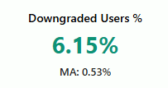
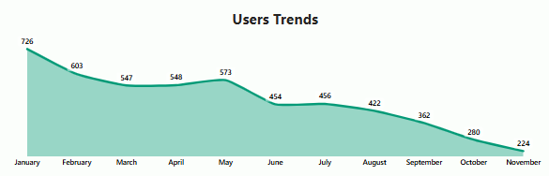
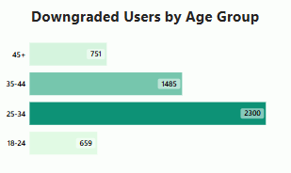
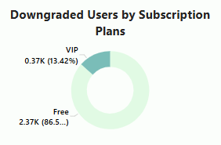
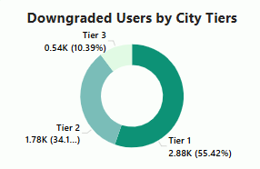
Q7. How do downgrade trends differ between LioCinema and Jotstar? Are downgrades more prevalent on one platform compared to the other?
JOTSTAR

Slide 24
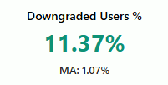
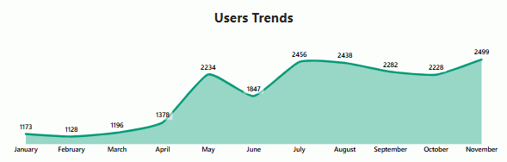
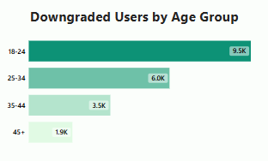
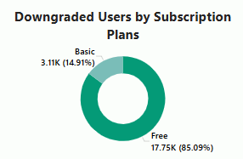
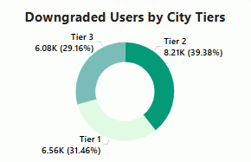
Q7. How do downgrade trends differ between LioCinema and Jotstar? Are downgrades more prevalent on one platform compared to the other?
LIOCINEMA

Slide 25
Insights & Recommendations
Insights:
Downgrades are higher among younger users (18-24 for Liocinema, 25-34 for Jotstar).
Free users contribute the most downgrades, indicating dissatisfaction with premium content.
Subscription downgrades could impact revenue stability.
Improving perceived value can reduce downgrade rates.
Both platforms need better retention incentives.
Recommendations:
Jotstar:
Offer more value-driven VIP benefits.
Improve customer engagement programs.
Reduce churn through personalized incentives.
Liocinema:
Strengthen premium content offerings.
Introduce loyalty rewards for long-term subscribers.
Enhance customer support for premium users.

Slide 26
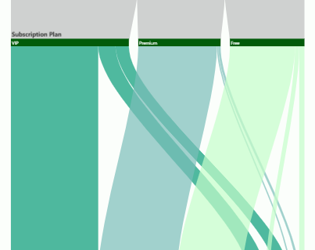
Q8. What are the most common upgrade transitions (e.g., Free to Basic, Free to VIP, Free to Premium) for LioCinema and Jotstar? How do these differ across platforms?
JOTSTAR
VIP to Premium: 2821 Users
6.32% of the total users
64.88% of the Upgraded Users
Free to Premium: 683 Users
1.53% of the total users
15.71% of the Upgraded Users
Free to VIP: 844 Users
1.89% of the total users
19.41% of the Upgraded Users

Slide 27
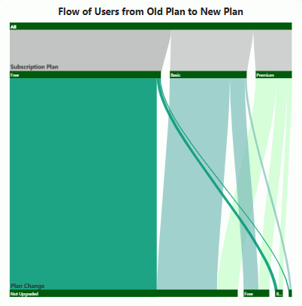
LIOCINEMA
Free to Basic: 2078 Users
1.13% of the total users
50.01% of the Upgraded Users
Basic to Premium: 1362 Users
0.74% of the total users
32.78% of the Upgraded Users
Free to Premium: 715 Users
0.39% of the total users
17.21% of the Upgraded Users

Slide 28
Insights & Recommendations
Insights:
Jotstar users mainly upgrade from VIP to Premium, while Free-to-VIP upgrades are slower.
Liocinema has strong Free-to-Basic conversions but struggles with Basic-to-Premium transitions.
Limited upgrade movement suggests pricing or content barriers.
Improving value perception can drive higher upgrades.
Better communication of premium benefits could enhance conversions.
Recommendations:
Jotstar:
Strengthen VIP-tier exclusivity.
Provide targeted promotions for upgrades.
Enhance premium user engagement.
Liocinema:
Offer incentives for Basic users to upgrade.
Improve messaging around premium features.
Test alternative pricing models.

Slide 29
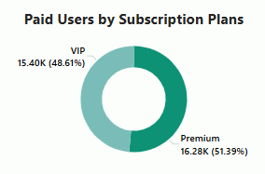
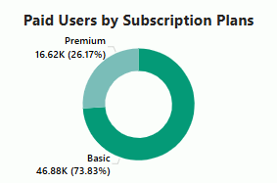
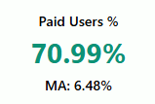





Q9. How does the paid user percentage (e.g., Basic, Premium for LioCinema; VIP, Premium for Jotstar) vary across different platforms? Analyse the proportion of premium users in Tier 1, Tier 2, and Tier 3 cities and identify any notable trends or differences.
JOTSTAR
LIOCINEMA

Slide 30
Insights & Recommendations
Insights:
Jotstar has a significantly higher percentage of paying users (70%) compared to Liocinema (34%).
Tier 1 dominates paid users for Jotstar, while Liocinema has more paying users from Tier 2 and 3 cities.
Premium-tier subscriptions drive revenue but require continuous value reinforcement.
Both platforms need localized strategies to increase conversions.
Paid user retention is crucial for long-term revenue stability.
Recommendations:
Jotstar:
Introduce flexible pricing for Tier 2 and 3 users.
Improve localized marketing strategies.
Enhance premium user perks.
Liocinema:
Strengthen premium offerings in Tier 1.
Offer discounts for Tier 2 and 3 users.
Improve subscription onboarding experience.

Slide 31

Q10. Revenue Analysis
Assume the following monthly subscription prices, calculate the total revenue generated by both platforms (LioCinema and Jotstar) for the analysis period (January to November 2024).
The calculation should consider:
❖ Subscribers count under each plan.
❖ Active duration of subscribers on their respective plans.
❖ Upgrades and downgrades during the period, ensuring revenue reflects the time spent under each plan.

Slide 32








Solutions
JOTSTAR
LIOCINEMA

Slide 33
Insights & Recommendations
Insights:
Jotstar generates $8.29M, 55% more than Liocinema’s $5.38M, despite having fewer users.
Premium users drive most revenue, but Liocinema relies more on Basic-tier subscriptions.
Higher-tier cities contribute the most revenue.
Strengthening conversion rates can boost financial performance.
Subscription diversification could open new revenue streams.
Recommendations:
Jotstar:
Expand premium-tier offerings.
Introduce bundled subscription packages.
Optimize pricing strategies for different user segments.
Liocinema:
Focus on converting Basic users to Premium.
Test alternative revenue models.
Strengthen upsell strategies.

Slide 34
SUMMARY
The comparison analysis of LioCinema and Jotstar highlights key differences in user engagement, content diversity, and revenue generation.
Jotstar has a higher percentage of paying users and better engagement, while LioCinema has a larger but more inactive user base.
Jotstar’s content library is more balanced across genres, whereas LioCinema is heavily movie-focused.
Liocinema has strong traction in Tier 2 and Tier 3 cities, while Jotstar dominates in Tier 1.
Revenue insights suggest that increasing content variety and personalized user engagement can enhance profitability.
These findings will guide the post-merger strategy to create a robust, market-leading streaming platform.

Slide 35
THANK YOU

